Slide 1
Practice your data presentation
Prepaired by
Motaz Saad
Fall 2016

Slide 2

Positioning
Pointing
Pointing out
Perception

Slide 3
Thinking
Analyse
Context
Type of data
Explanation of data
Conclusion

Slide 4
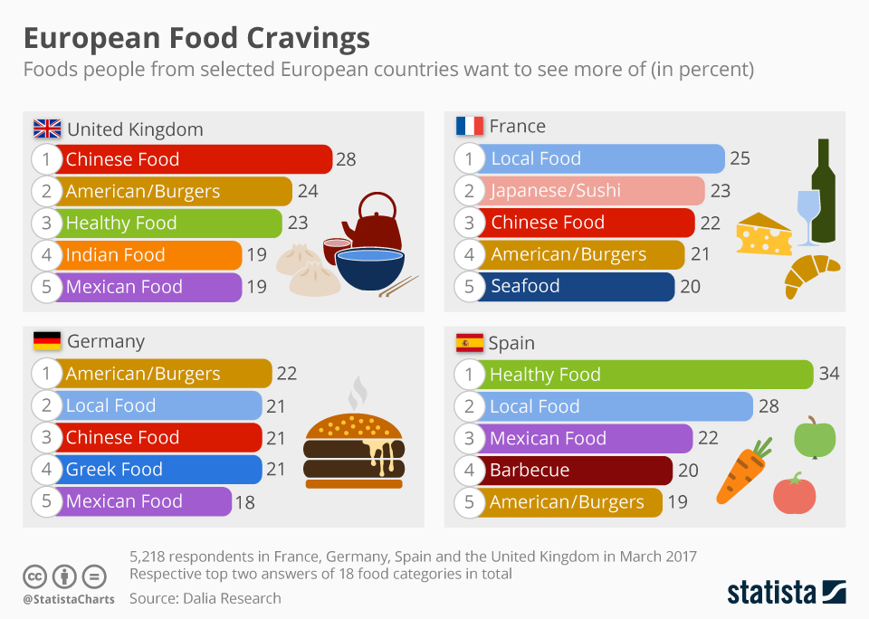

Slide 5
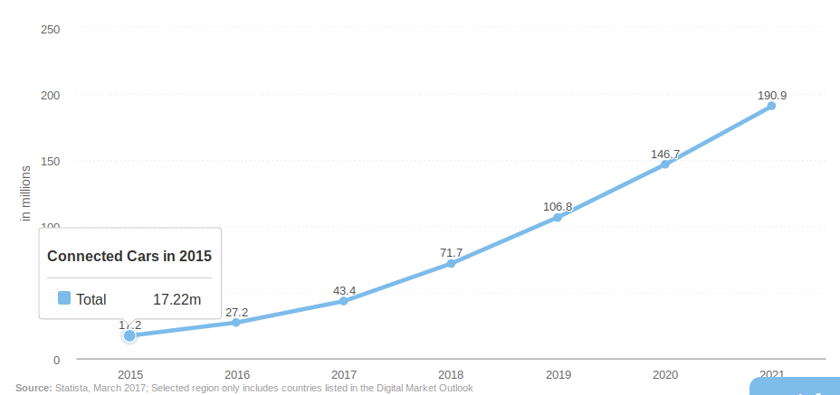
Number of connected cars

Slide 6
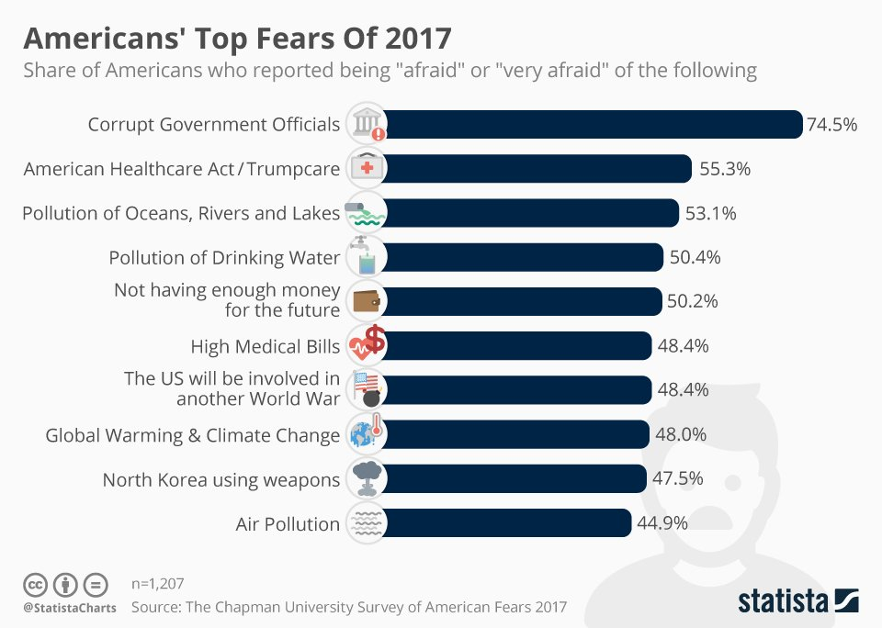

Slide 7
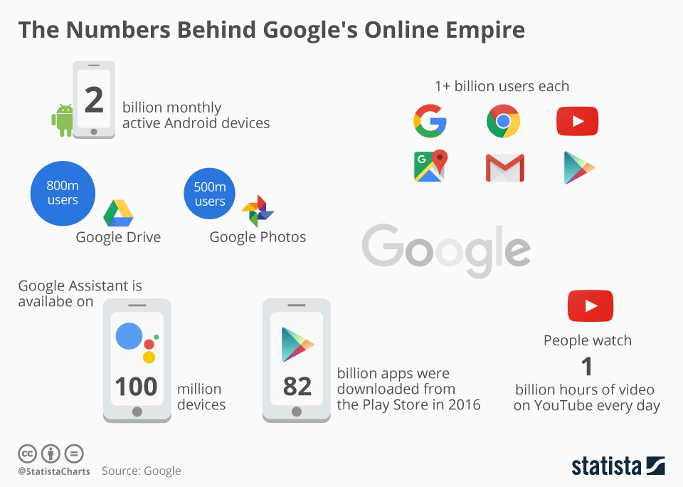

Slide 8
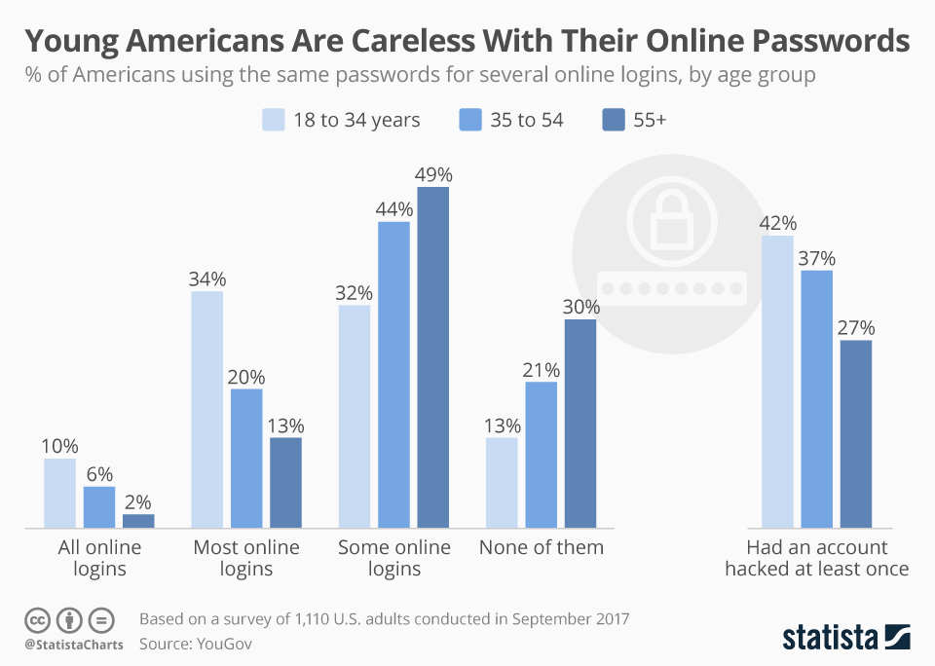

Slide 9
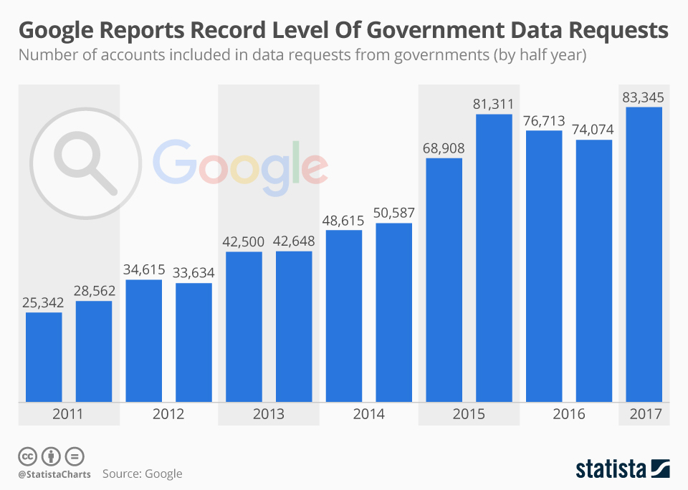

Slide 10
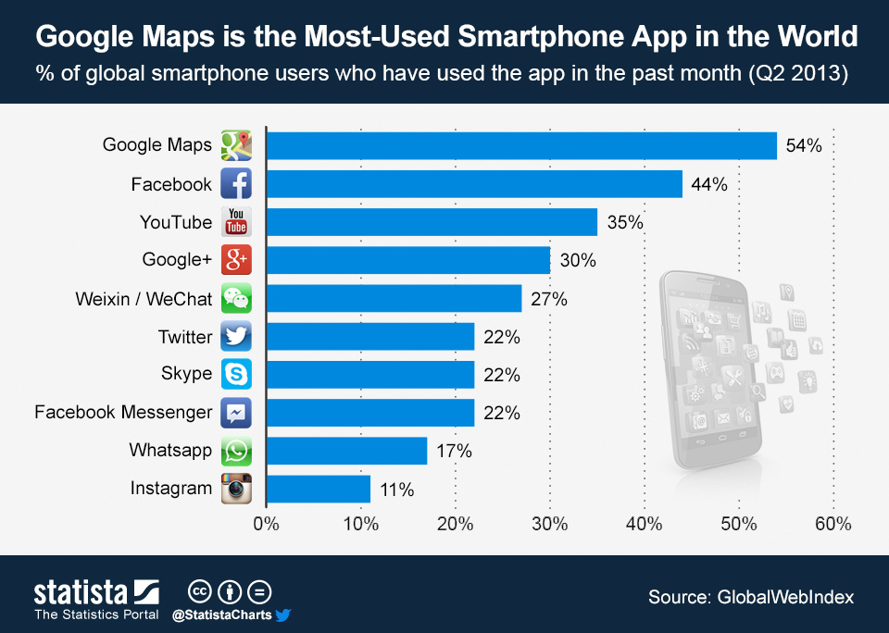

Slide 11
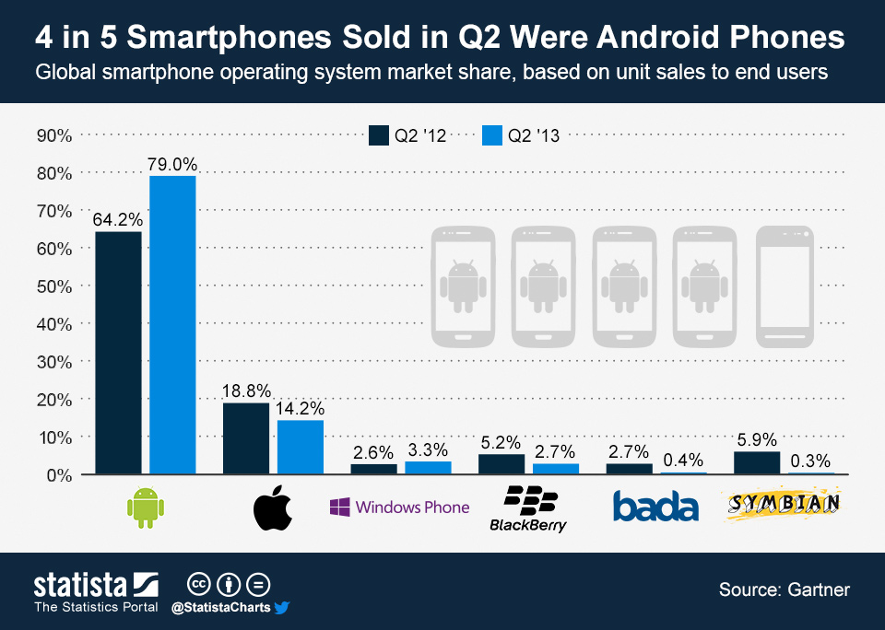

Slide 12
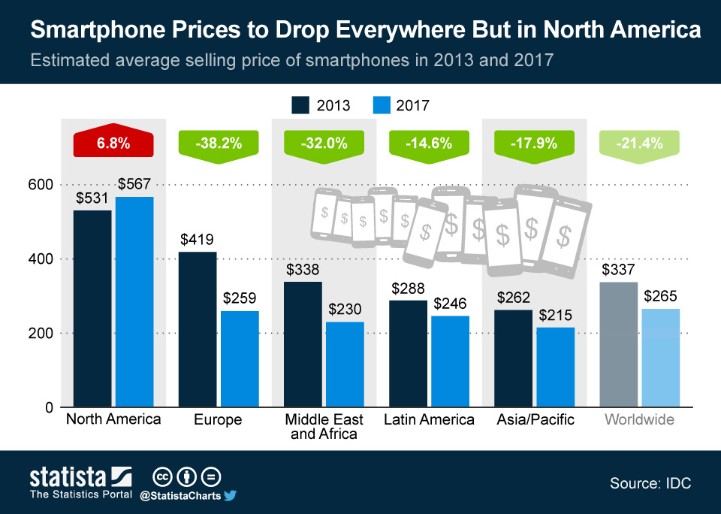

Slide 13
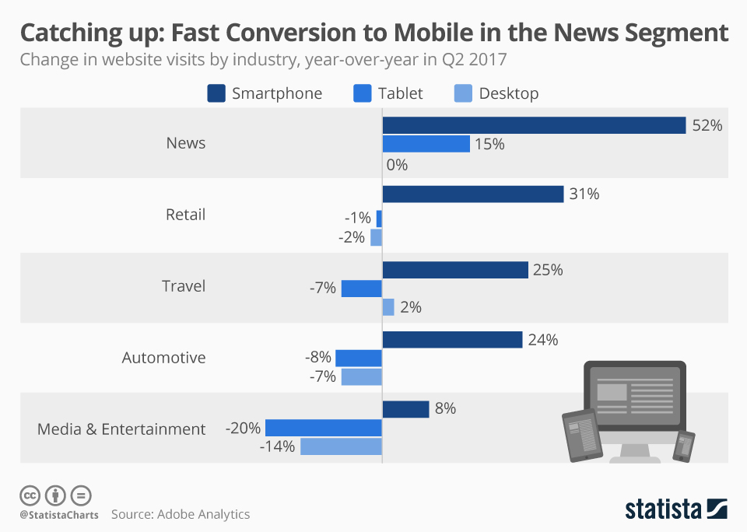

Slide 14
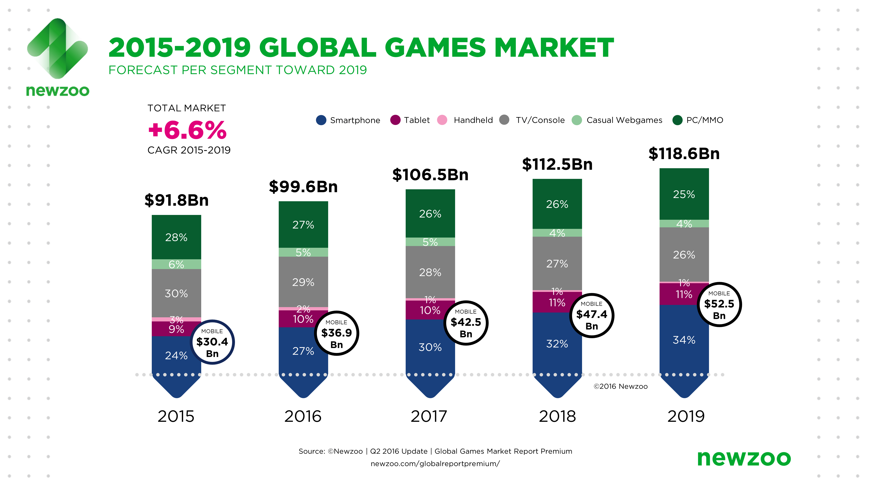

Slide 15
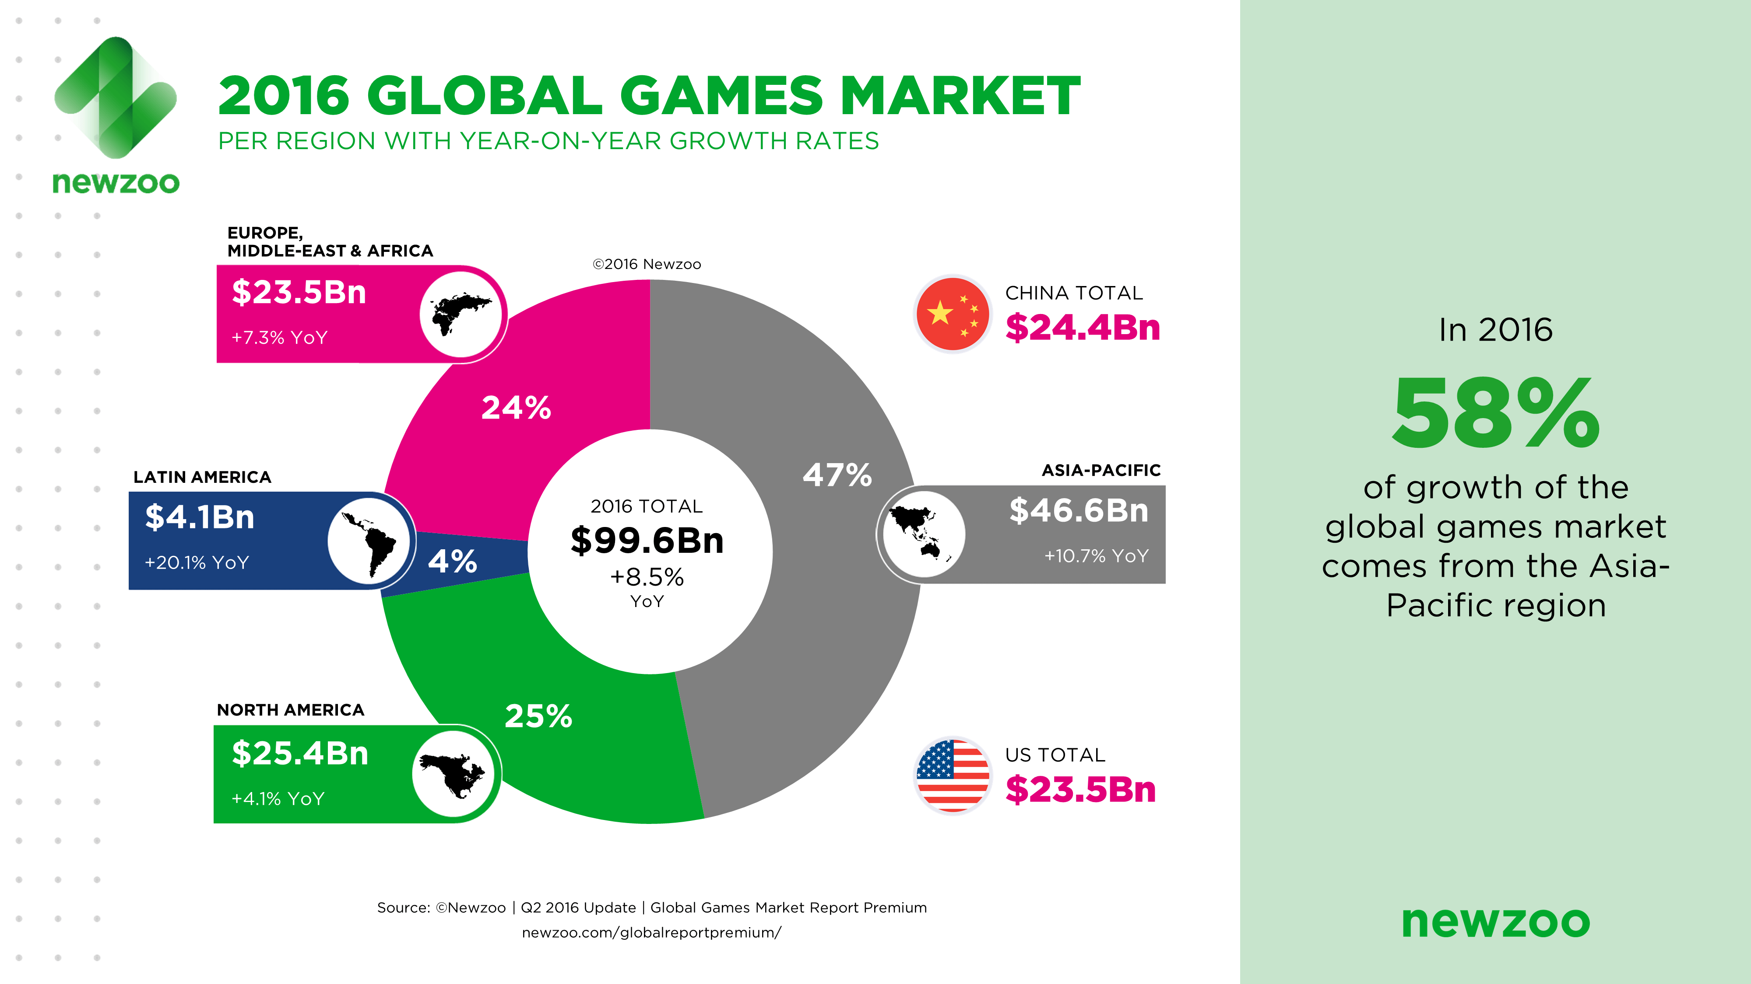

Slide 16
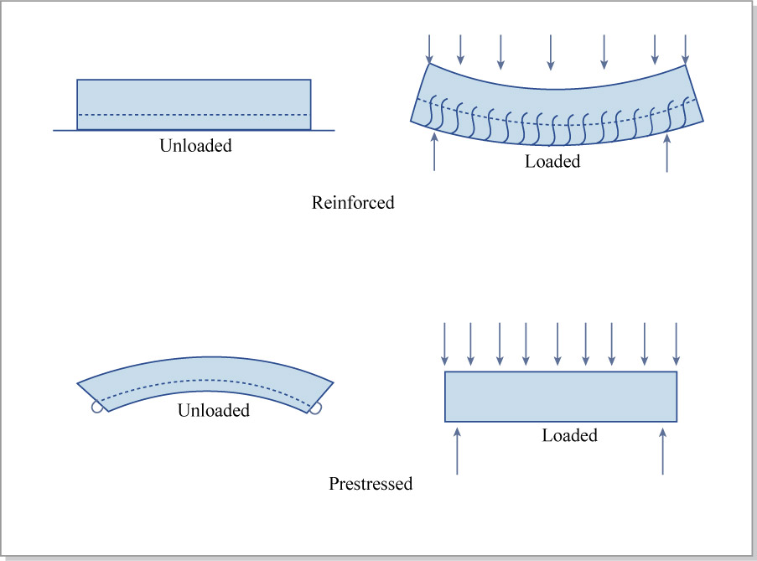
Concrete types

Slide 17
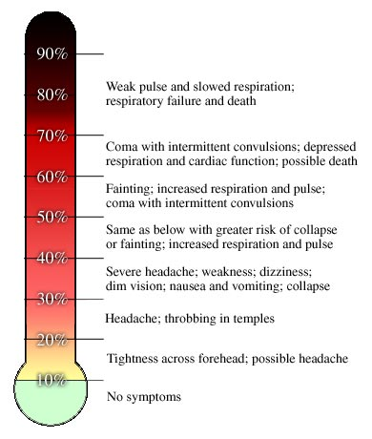
Carbon Monoxide poisoning
% of Fe sites occupied by CO

Slide 18
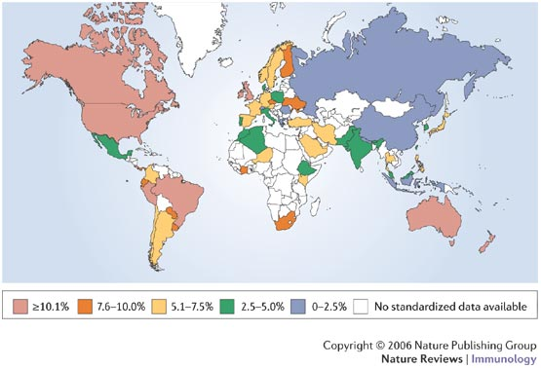
The association between a westernized lifestyle and asthma

Slide 19
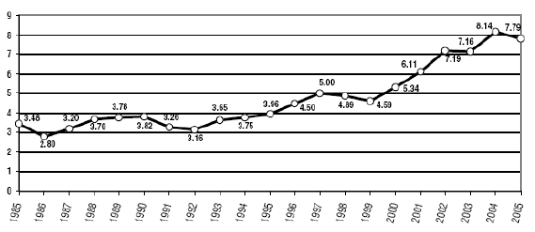
Average % THC in Marijuana Seizures
Recent seizures in Atlanta had plants with 18% THC content.
http://www.usdoj.gov/ndic/pubs11/18862/images/fig1.gif

Slide 20
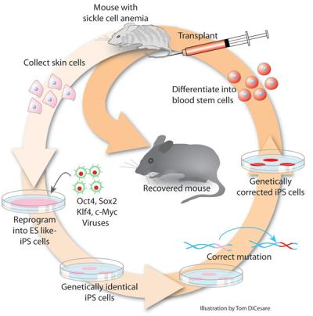
Scientists Cure Sickle Cell Anemia in Mouse Model
Source : http://medgadget.com/2007/12/scientists_cure_sickle_cell_anemia_in_mouse_model.html

Slide 21
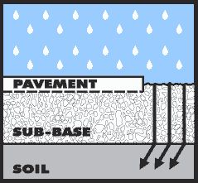
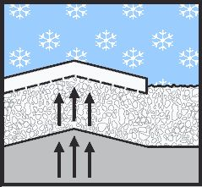
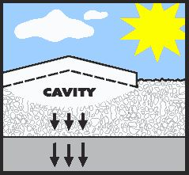
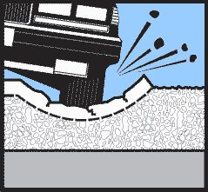
Pothole formation
1
2
3
4

Slide 22
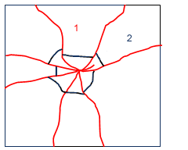
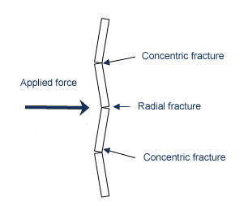
How does glass break?
2
1
2
www.channel4.com/.../science/images/fracture.gif

Slide 23
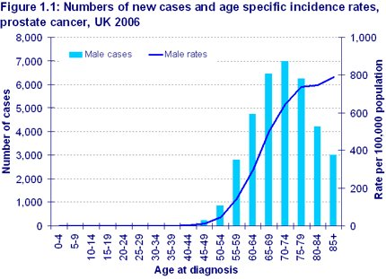
Source : http://info.cancerresearchuk.org/cancerstats/types/prostate/incidence/uk-prostate-cancer-incidence-statistics

Slide 24
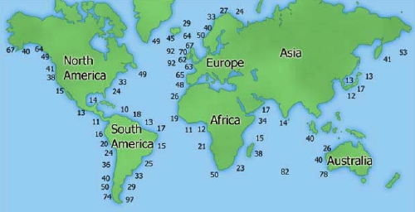
Tidal energy potential
(KW/M)

Slide 25
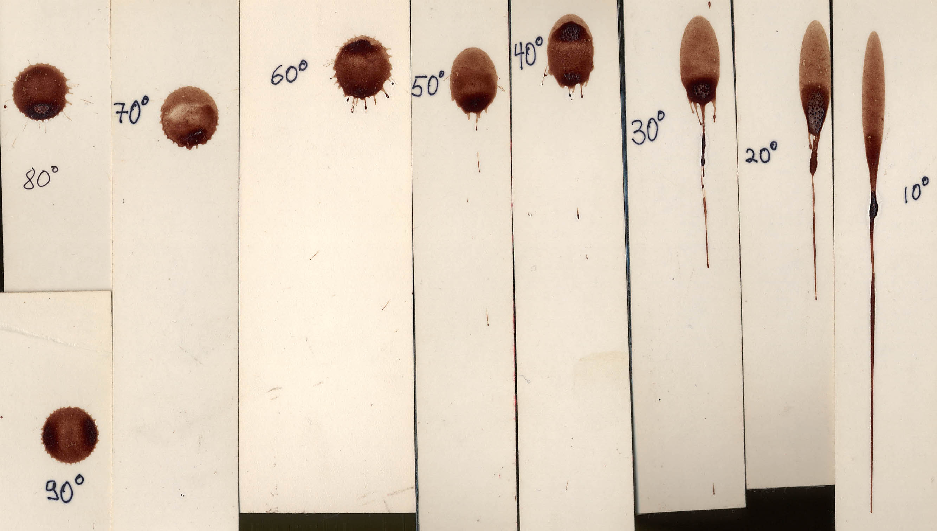

Blood splatter : Angle of Impact
http://www.bergen.org/EST/Year5/images/splatterangle.jpg

Slide 26
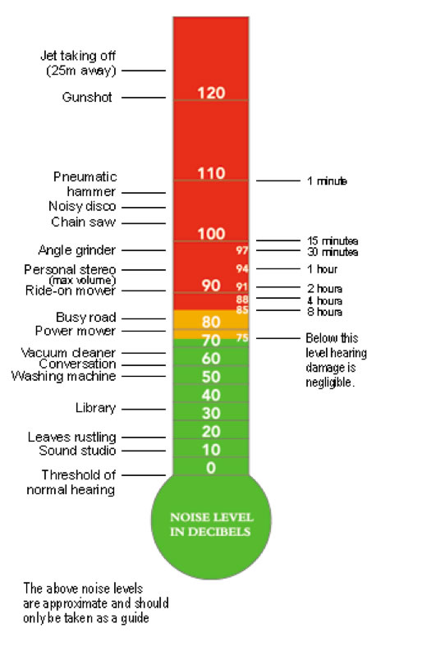
Hearing damage
Source: http://www.livewelllivelong.com/

Slide 27
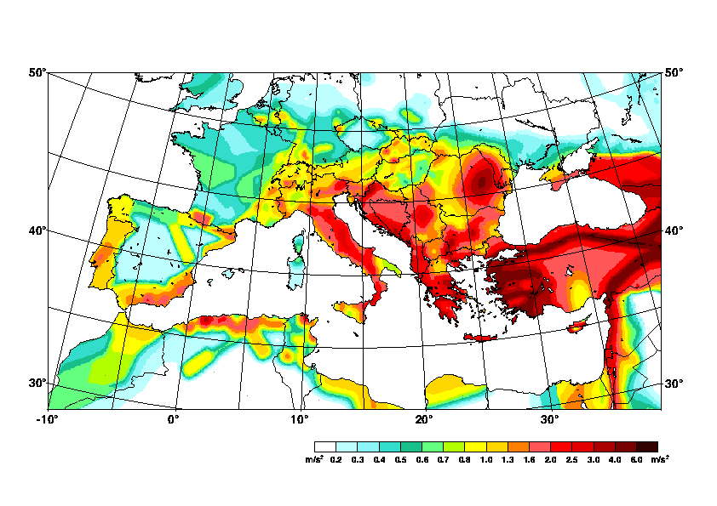
Seismic risk

Slide 28
End of Slides

